Slide 1
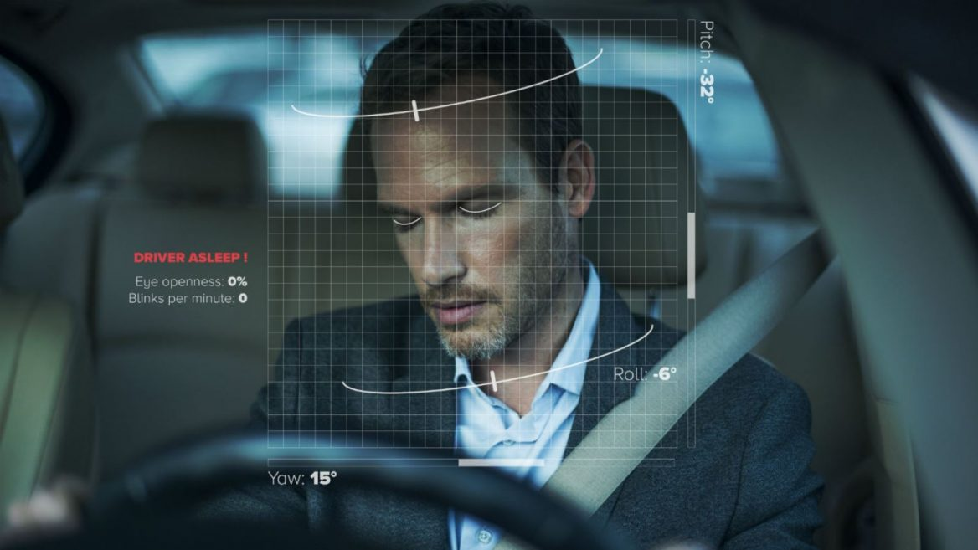
Team 23
Driver Drowsiness
Detection
PRESENTERS INFORMATION 2010030309-K MANIDEEP REDDY 2010030064-I KAUSTUBH SASTRY 2010030457-M ABHIRAM 2010030197-K V MANOHAR KARTHIK

Slide 2
TABLE OF CONTENTS
INTRODUCTION
WORKFLOW-FLOW
GITHUB COMMITS
WORK PROGRESS
ALPHA TESTING
REFERENCES

Slide 3
INTRODUCTION
Drowsy Driving is a deadly combination of driving and sleepiness. The number of road accidents due to Drowsy Driving is increasing at an alarming rate worldwide. Not having a proper sleep is the main reason behind drowsiness while driving. However, other reasons like sleep disorders, medication, alcohol consumption, or driving during night shifts can also cause drowsiness while driving.

Slide 4

WORKFLOW -FLOWCHART

Slide 5
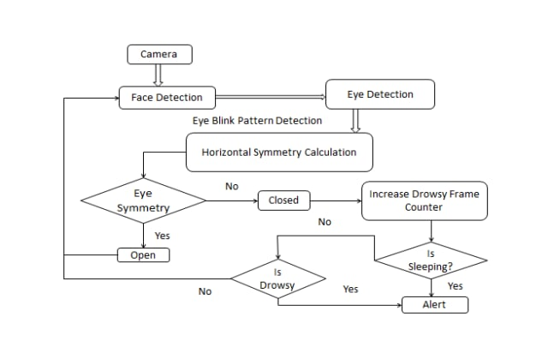
WORKFLOW
High vision cameras are embedded to monitor and capture to extract frames one by one and generate the alerts accordingly. Each extracted frame is analyzed to study the pattern of facial features; using Haar Cascade Classifier and determined Eye Aspect Ratio(EAR) and Mouth Aspect Ratio(MAR) for each frame. EAR and MAR values exceed their respective threshold values, a blink and a yawn is considered respectively. The system alerts the driver by playing an alarm if eye blinking rate and yawns are suspected for a certain number of consecutive frames. The alarm is activated to grab the driver’s attention and it keeps on ringing until driver wakes up.

Slide 6

GITHUB COMMITS

Slide 7
GITHUB COMMITS
We created the repository under the name of the project chosen
We then uploaded the following files into it the documentation files into it
The repository link is https://github.com/2010030064-kaustubh/Driver-drowsiness-detection-system

Slide 8
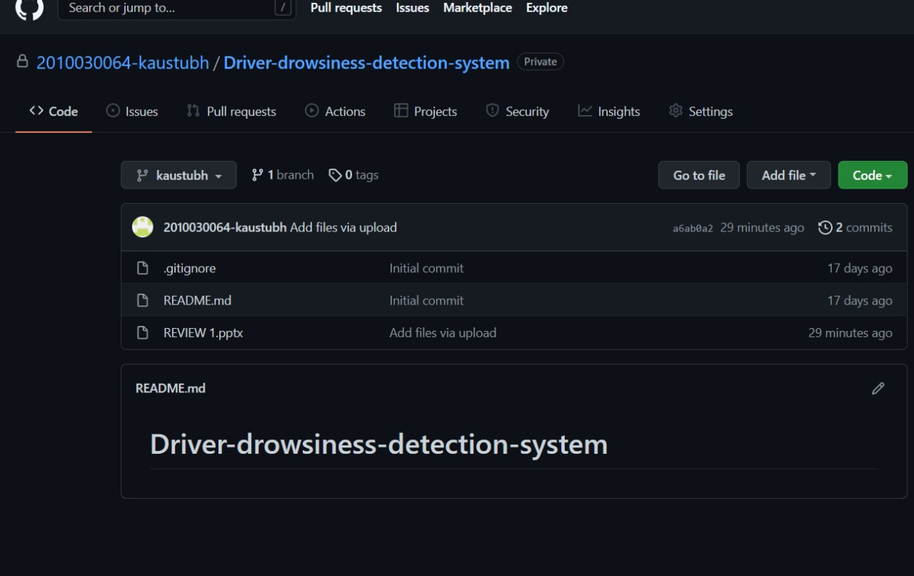

Slide 9

WORK PROGRESS

Slide 10
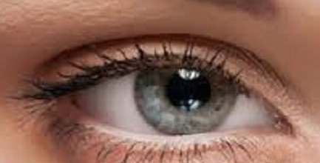
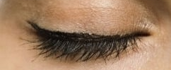
WORK PROGRESS
We browsed the internet to find the ideal dataset required for the project, the project requires identification of the user (present in frame) eye and mouth detection, the dataset we found contains around 1452 images ,where in there is a division in again 2 categories , open eye and closed eye, the data has inputs with various weather and climate conditions .

Slide 11
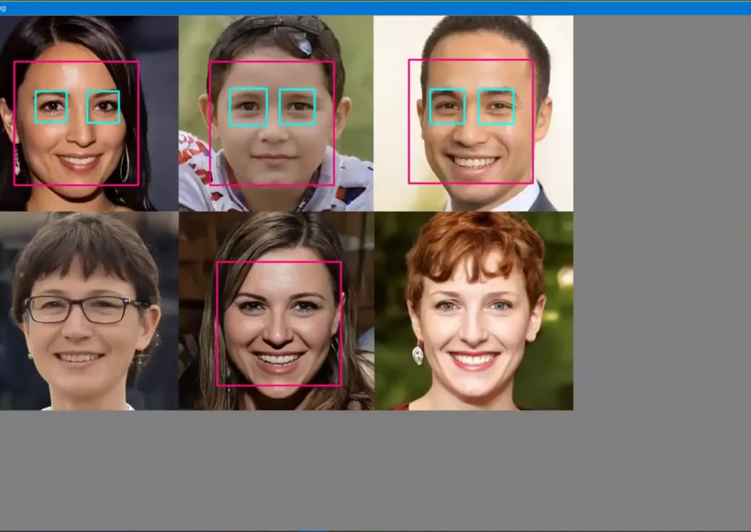
PYTHON LIBRARIES REQUIRED
Using the above dataset and libraries called “dlip” and “imutilis” , the model built will be able to detect if the user in frame is drowsy and using the concepts of i.ot the sensors will trigger the sound alerts

Slide 12
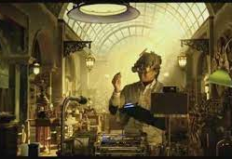
ALPHA TESTING

Slide 13
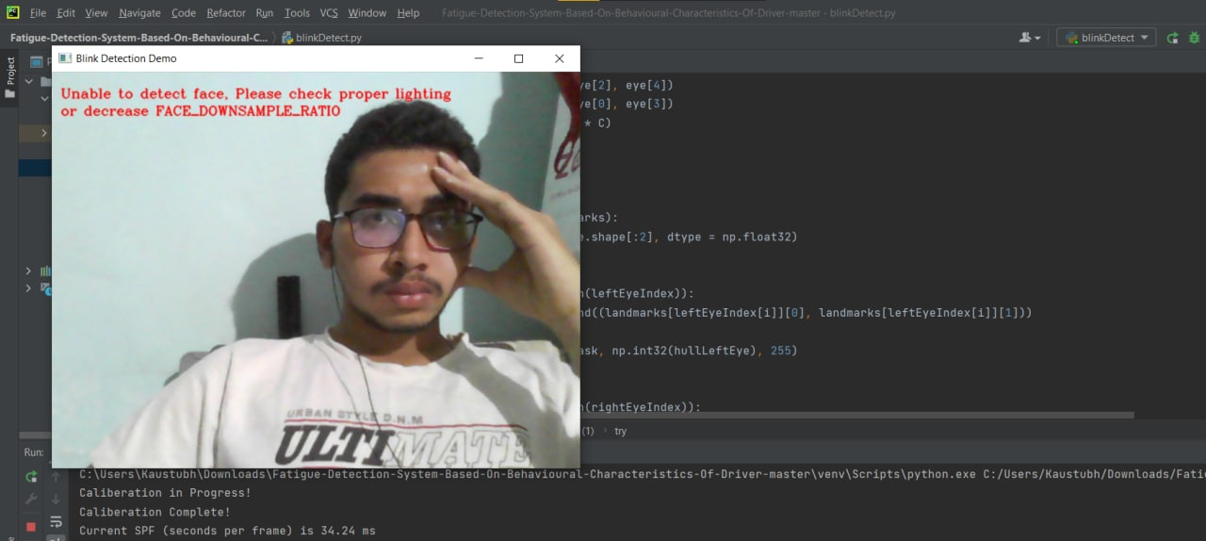
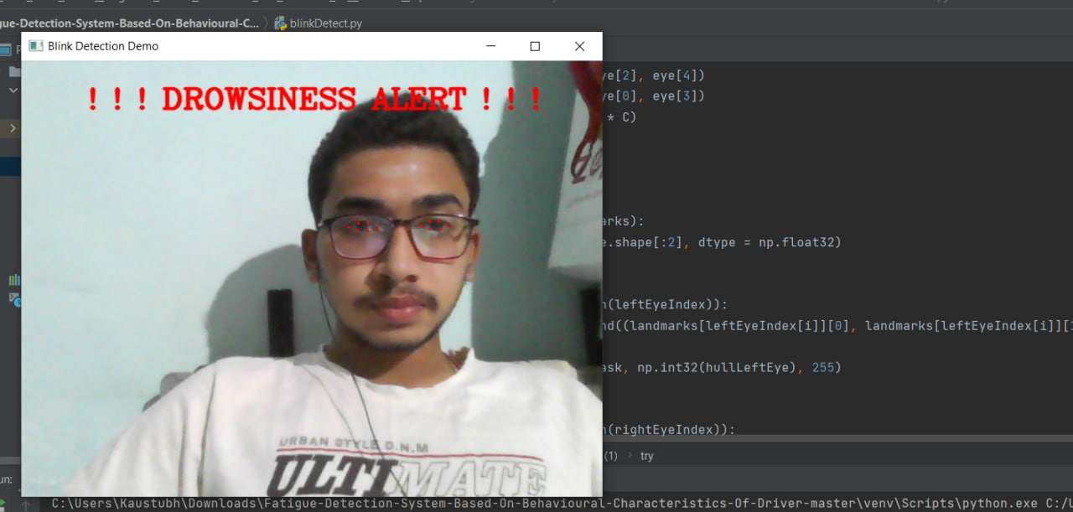
We have tested the project using various test conditions
Our findings were
1.The project logic works just fine, and it covers majority of problem statement.
2.we have identified some flaws In the project working.

Slide 14

REFERENCE’S

Slide 15
We have referred the following links and research papers to learn about the project in detail
https://www.ijset.in/wp-content/uploads/NCCIP53.pdf
https://www.isrjournals.org/journals/computerscience_information_technology_journals/adriverfacemonitoringsystemforfatigueanddetction1617127262.pdf
https://www.researchgate.net/figure/Flow-chart-of-drowsiness-detection-algorithm_fig2_311706147
https://www.kaggle.com/dheerajperumandla/drowsiness-dataset

Slide 16
THANK YOU

